Slide 1
Lecture 3 Use Case Diagram
Chapter 17 & 18
The Unified Modeling Language User Guide
SECOND EDITION
By Grady Booch, James Rumbaugh, Ivar Jacobson
Session 5 & 6
UML Weekend Crash Course
Thomas A. Pender

Slide 2
Objective
Capture the intended behavior of the system
Without specifying how that behavior is implemented.
Use cases provide a way for developers to come to a common understanding with your system's end users and domain experts.
In addition, use cases serve to help validate your architecture and to verify your system as it evolves during development.
Use cases specify WHAT are the externally visible behaviors; they DO NOT dictate HOW that behavior will be carried out internally.

Slide 3
What is Use Case?
A use case is a description of a set of sequences of actions, including variants, that a subject performs to yield an observable result of value to an actor.
For example, one central use case of a bank is to process loans for its loan applicants/ clients/ customers.

Slide 4
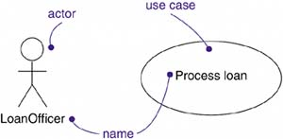
What is Actor?
An actor represents a coherent set of roles that users of use cases play when interacting with these use cases.
Actors can be human or they can be automated systems.
For example, in modeling a bank, processing a loan involves, among other things, the interaction between a customer and a loan officer.

Slide 5
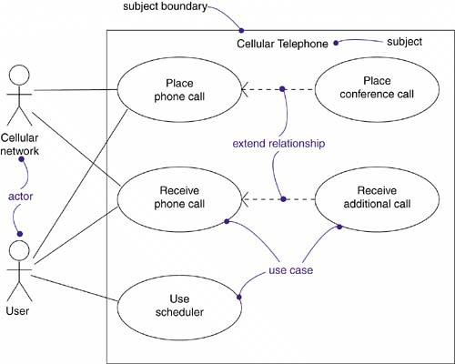
Use Case Diagram
Apply use case diagrams to visualize the behavior of a system, so that users can comprehend how to use that element, and so that developers can implement that element

Slide 6
Modeling the Requirements of a System
Establish the context of the system by identifying the actors that surround it.
For each actor, consider the behavior that each expects or requires the system to provide.
Name these common behaviors as use cases.
Factor common behavior into new use cases that are used by others; factor variant behavior into new use cases that extend more main line flows.
Model these use cases, actors, and their relationships in a use case diagram.
Enhance these use cases with notes or constraints that assert nonfunctional requirements; you may have to attach some of these to the whole system.

Slide 7
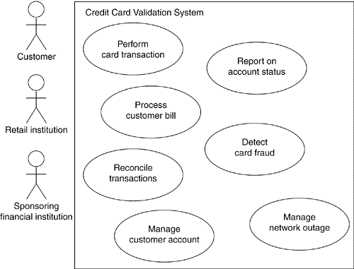
Modeling the Requirements of a System

Slide 8
Elements of Use Case Diagram

Slide 9
Relationships in Use Case Diagram
Association
Between Actor and Use Case
NOT between Use Cases
Generalization
Between Actors
Between Use Cases
Dependency
Between Use Cases
<<include>> and <<extend>>

Slide 10
Actors
Find the people, systems, or devices that communicate with the system.
The system-type actors are often easiest to spot as interfaces and external communication, such as notifications to the Accounts Payable and Order Processing systems.
The other actors will be participants in the operation of the Inventory Control system.
All these users will become sources for finding and validating the required features of the system (that is, Use Cases).

Slide 11
Notation of Actors

Slide 12
Dependency
<<include>>
Mandatory dependency
<< i >>
Arrow towards the use case dependent on
<<extend>>
Optional Dependency
<< e >>
Arrow from the use case dependent on
Often referred as options of the use case

Slide 13
<<include>> & <<extend>>

Slide 14
Generalization

Slide 15
Use Case Diagrams - practice
Case 1:
In a hotel management system a guest can rent rooms. Hotel receptionist uses the system to assist in the renting. A guest can also book a room for future renting with the help of the receptionist, but the receptionist has to check if the room has prior booking or not. A Guest can pay for his bill. He can pay by cash or credit card. Receptionists has to logon to the system before they can use it, but to logon he has go through username/password verification.
Hotel Management System
Rent Room
Book Room
<<include>>
Check Availability
Guest
Receptionist
<< e >>
Pay Bill
<<extend>>
Pay by cash
Pay by card
verify
login
<< i >>

Slide 16
Use Case Diagrams - practice
Music Today
Case 2:
Music Today is an audio recording company. There are several recordists in the company. Clients record their music with the help of the recordists. The recording is done in a session. A session is usually created by the office clerk. A session needs to be booked by the client beforehand and before booking the time needs to be verified by the office clerk for availability. The company maintains a list of preferred clients who book sessions like regular clients but also can create sessions according to their needs. Clerks have to log in to use the system. Clients can pay in cash or card. The accounts department deals with the payment. The payment is only cleared when the accounts department receives clearance from the office clerk.
Record Music
Preferred
Client
Create Session
Recordist
Book Session
Check Availability
<< i >>
Office Clerk
Client
Pay Bill
<<extend>>
<< e >>
Pay by cash
Pay by card
<< i >>
Clearance
<< actor >>
Accounts
login

Slide 17
Use Case Diagrams - practice
Case 3:
ABCD Records is a mail order company that distributes CDs and tapes at discount prices to record club members. A member fills up an order form and sends it to the order processing clerk. When the order processing clerk receives an order form, she verifies that the sender is a club member by checking the member file. She also checks the status of the member whether he is a royal class member or regular class member. If the sender is not a member, the clerk returns the order along with a membership application form. If the customer is a member, the clerk verifies the order item data by checking the item file. Then the clerk enters the order data and saves it to the daily records file. At the same time the clerk also prints an invoice and shipping list for each order, which are forwarded to the collection department clerk for processing there. If the items are not available and if the member is a royal class member, items are ordered by the Oder Processing Clerk. Royal class members also get discounts. The members can pay by cash, check or bank draft.

Slide 18
Use Case Diagrams - practice
Case 4:
In a hospital management system a patient's medical history is created by a doctor. A patient may be referred by a doctor to be admitted in the hospital. A patient can rent hospital facilities. An administrative officer deals with the renting. The system automatically checks whether the patient is referred by a doctor before he can rent any hospital facility. The types of facilities are rooms, beds or ICUs. Admitted patients are regularly visited by doctors and a nurse updates patient medical history after each visit. A doctor writes the discharge note of the patient when he leaves. An account clerk prepares the bill. The bill is calculated from the elements written in the medical history, i.e. number of doctor's visit, prescribed medication, tests. When the nurse updates the medical history she writes either the date-time of doctor's visit or prescribed medication or test. The patient may pay by cash or card when the bill is prepared.

Slide 19
More on Use Case Model
Use Case Narrative
Use Case Scenarios

Slide 20
Use Case Narrative/ Description
Version 1:
Name
Assumption: conditions that must be true, but are not tested in this Use Case.
Preconditions: conditions that must be true, and are tested in this Use Case.
Use Case Initiation: describes how to start a Use Case.
Process of Dialog: how the user (whether an actor or another Use Case) interacts with the system during the execution of the Use Case.
Use Case Termination: define the different mechanisms that can cause the Use Case to stop execution.
Postconditions: define the state of the system that must be true when the Use Case ends.

Slide 21
Example: Version 1
Name | Fill Order
Assumptions | Valid user and has permission to use this feature
Pre-conditions | Provide a valid order number
Use Case initiation | This Use Case starts on demand
Use Case dialog | The system asks the user for an order number The user provides the order number. If the Order is not found, Error, stop Else: The system provides the order detail to the user The user chooses an item Until the user indicates that he is done or there are no unfilled item quantities The system looks for the location of the item If the item is found (available): The user indicates the quantity of the item filled If there are any unfilled item quantities greater than 0: Create a backorder (using the Create Backorder Use Case)
Use Case termination | The user may cancel The Use Case may timeout The user can indicate that he is done
Post-conditions | Normal termination: The changes to the Order must be saved Cancel: The Order must be saved unchanged

Slide 22
Use Case Narrative/ Description
Version 2:
Name
Short description
Precondition: prerequisite for successful execution
Postcondition: system state after successful execution
Error situations: errors relevant to the problem domain
System state on the occurrence of an error
Actors that communicate with the use case
Trigger: events which initiate/start the use case
Standard process: individual steps to be taken
Alternative processes: deviations from the standard process

Slide 23
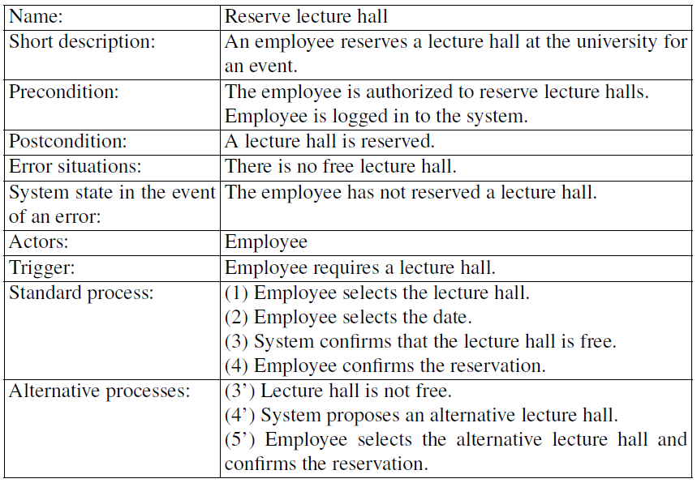
Example: Version 2

